Slide 1
Onboard Flight Management with Artificial Intelligence
Shih-Yih (Ryan) Young, Ph.D. 楊世義博士
Technical Fellow
Advanced Technology Center
Mission Systems
Collins Aerospace
United Technologies Corporation
Email: Ryan.Young@collins.com

Slide 2
Outline
My Background
Flight Management Systems/Mission Computers
Automatic 4-D Flight Re-planning
Automatic Determination of Optimal Neural Network Topologies
High Integrity GPS/INS Integration for Automatic Precision Landings
Summary

Slide 3
My Background

Slide 4



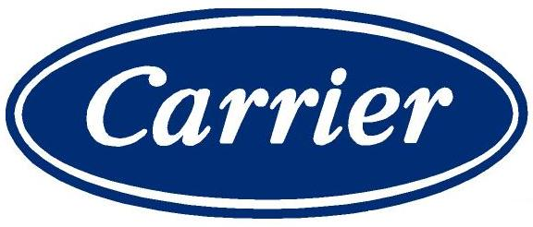

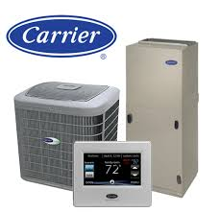
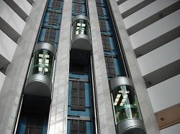
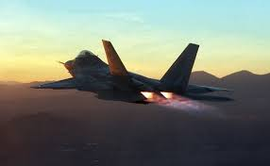
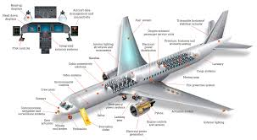
United Technologies Corp (UTC)
Elevators
Environmental Controls
Aircraft Engines
Aircraft Cockpit and Systems
United Technologies Corporation has more than 200,000 employees all over the world
Collins Aerospace is the biggest business segment under UTC

Slide 5

Collins Aerospace
1
2
3
4
Avionics
Mission Systems
Advanced Technology Center
Collins Aerospace has six business divisions and about 70,000 employees
Both Mission Systems and Avionics divisions are headquartered
in Cedar Rapids, Iowa
I am a Technical Fellow under Advanced Technology Center and support
both Mission Systems and Avionics divisions

Slide 6
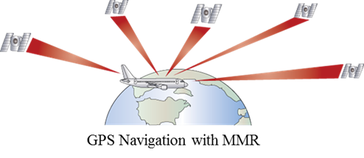
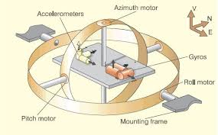
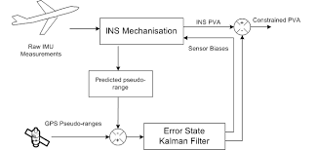
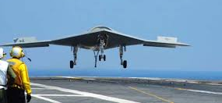
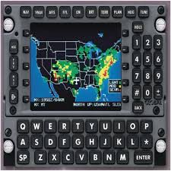
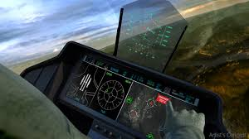
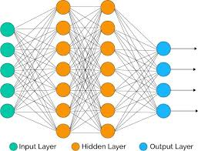
My Domains of Expertise
High integrity GPS/INS integration
  Global Positioning System (GPS)
  Inertial Navigation System (INS)
Precision Navigation for Automatic Landing Systems
Flight Management System (FMS)
Pilot Decision Aids
Multi-objective Optimization with Neural Networks

Slide 7
Flight Management Systems/Mission Computers

Slide 8
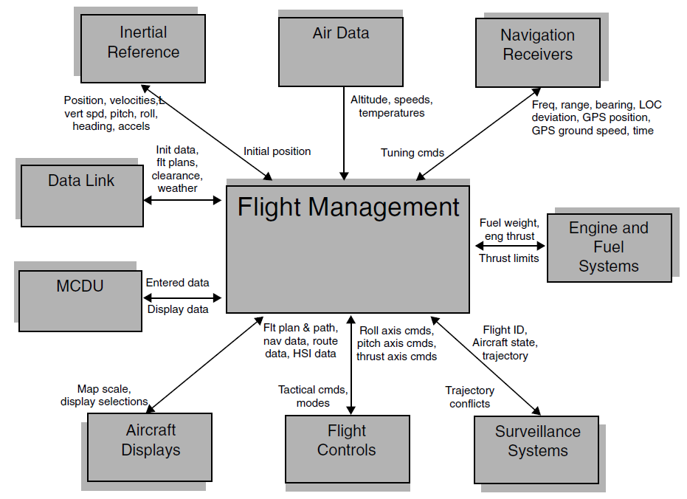
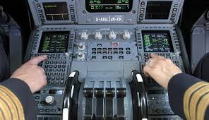
Flight Management System (FMS)
Each aircraft has two FMSs for redundancy
FMS Interfaces
Flight Management System/Mission Computer is the brain of the aircraft

Slide 9
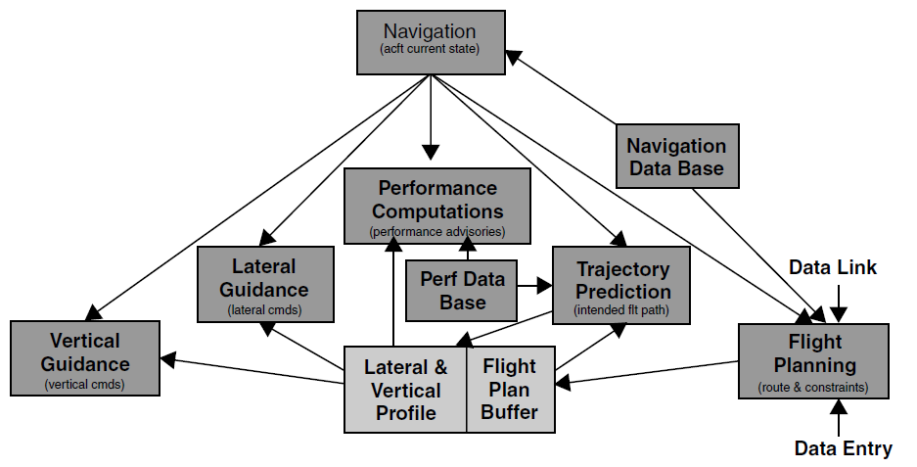
FMS Functional Blocks
The FMS performs multiple function that are essential for a safe and efficient flight

